Slide 1


Lane Detection Using OpenCV
Semester project
Group Members
Abdul Basit 193227
Muhammad Abdullah Kazmi 188990
Raeed Asif 199323

Slide 2
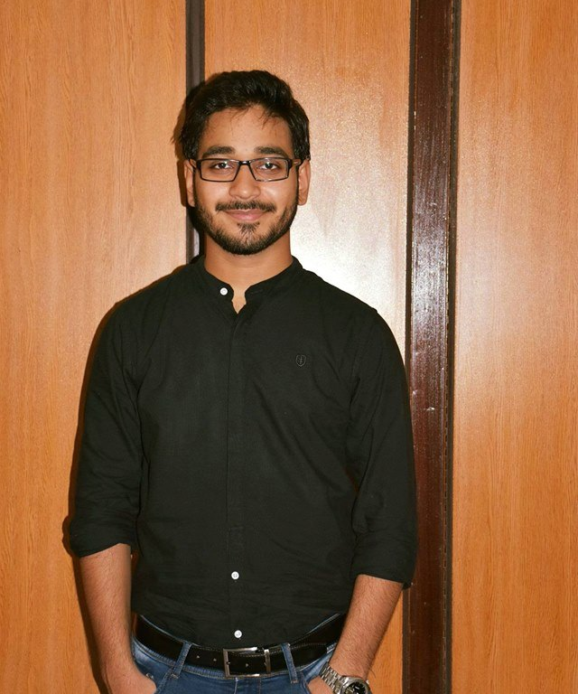
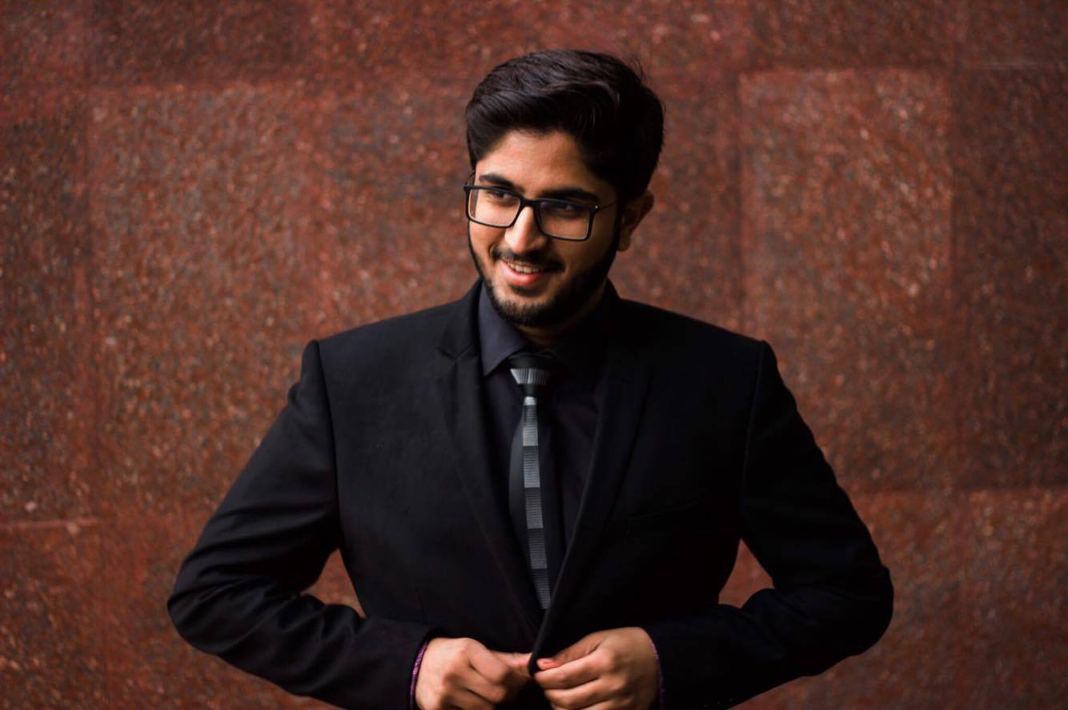
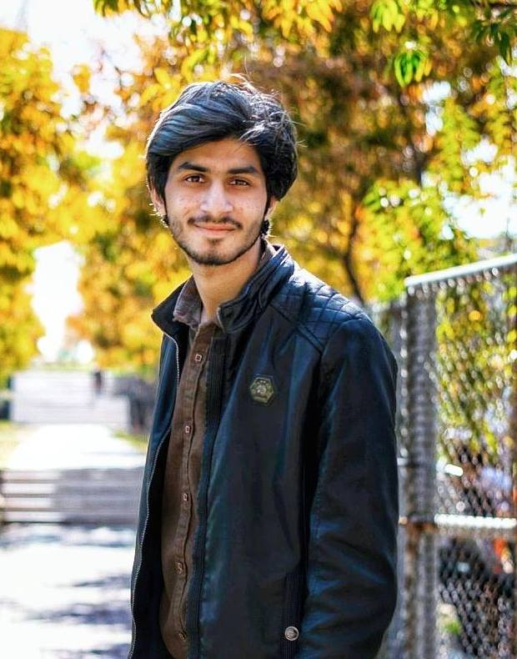
Infographic Style
Meet Our Team
Raeed Asif
Abdul Basit
Muhammad Abdullah Kazmi
BSCS-6B
199323
BSCS-6B
193227
BSCS-6B
188990
Student
Student
Student

Slide 3
Outline
01
Introduction
02
Problem Statement
03
Literature Review
04
Proposed Solution Approach
05
Implementation
06
Final Product

Slide 4
Introduction

Slide 5
Introduction
Our project is Lane Detection in self driving cars. It automatically detects road lanes.

Slide 6
Problem Statement

Slide 7
Problem Statement
We use our eyes to decide where to go, the lanes on the road act as a reference and helps us decide where to steer the vehicle.

Slide 8
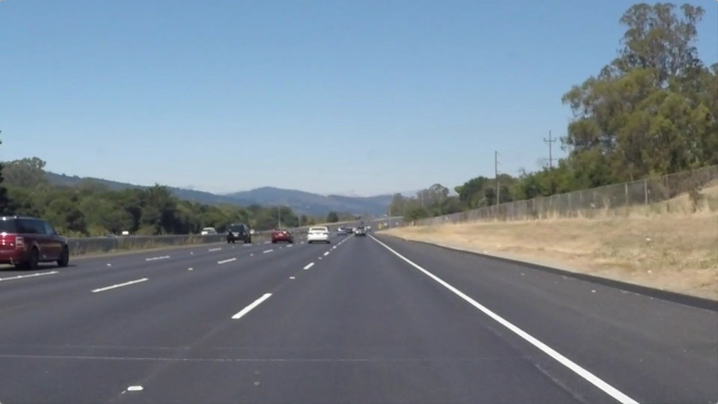

Slide 9
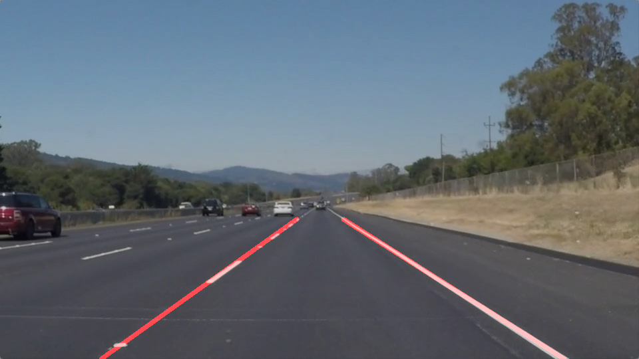

Slide 10
The Approach

Slide 11
The Approach
Convert images to grayscale using OpenCV.
gray_image = cv2.cvtColor(image, cv2.COLOR_BGR2GRAY)

Slide 12
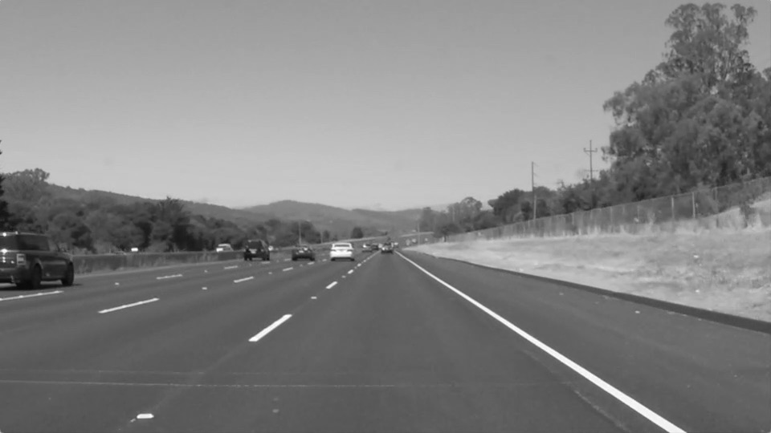

Slide 13
Guassian Blur
Gaussian Blur filter suppress noise in our canny edge detection by averaging out pixel in the neighborhood.

Slide 14
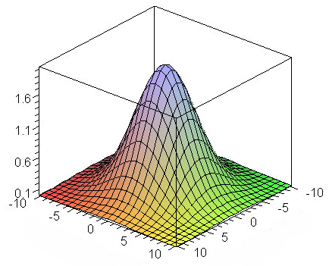

Slide 15
Hue Value Saturation
Lane lines are usually yellow or white. We used HSV as yellow lines on road can be difficult to isolate in RGB space

Slide 16
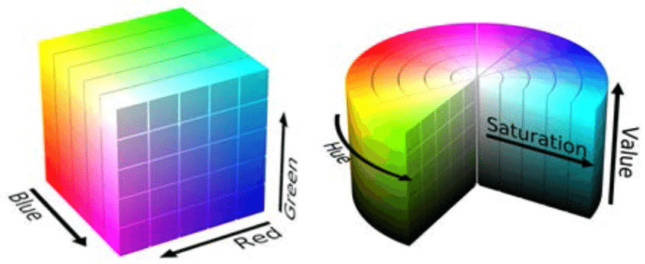

Slide 17
Region of interest
Our lane detections focuses on what’s there in front of our car by region of interest(ROI).
Everything outside ROI will be set to black.

Slide 18
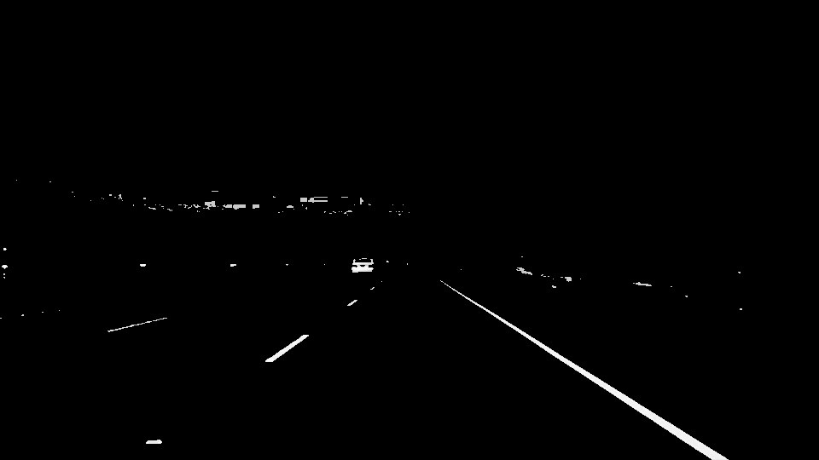

Slide 19
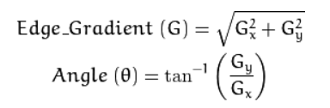
Canny Edge Detection
Canny() parses the pixel values according to their directional derivative(i.e gradient)
Supply thresholds for canny() as it computes the gradient.

Slide 20
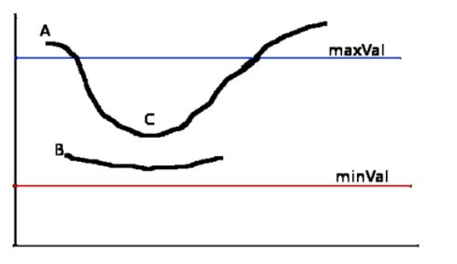

Slide 21
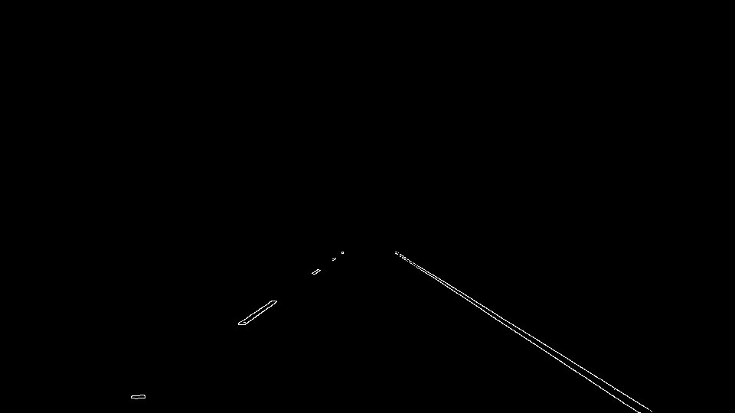

Slide 22
Hough Space
Pixels are considered points in XY plane.
Hough_lines() transform these points to lines.
When these lines intersect, these are point of intersection in hough space.
Everything outside ROI will be set to black.

Slide 23
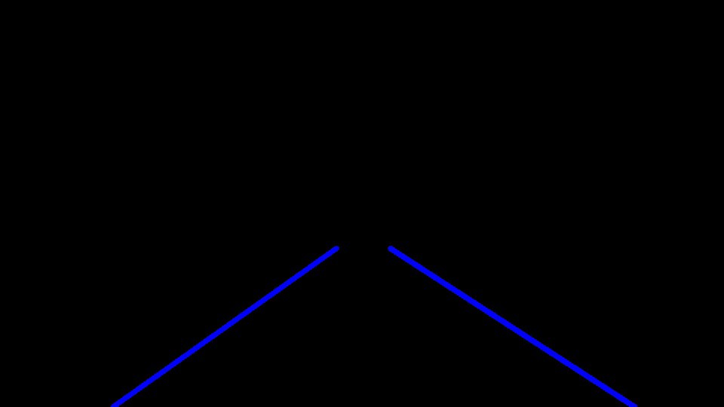

Slide 24
Technical Diagram of Solution
Step 2
Step 4
Hue Value Saturation
Canny Edge Detection
Step 1
Step 3
Step 5
Convert image to GrayScale
Guassian Blur Filter
Hough lines

Slide 25
DEMO

Slide 26
Thank You

Slide 27


